Slide 1
What Could It Look Like?: A Case Study Moses Rifkin mrifkin@universityprep.org University Prep, Seattle, WA @RiPhysKin
“There's really no class that would be "better" to talk about it in, and race in physics are intertwined when you look at the statistics.”
“It does relate to what we learn. By discussing it in physics, we are able to connect what we have learned to other things in ‘real life.’ By learning about it, I feel less discouraged from perhaps pursuing a course in math or science.”

Slide 2
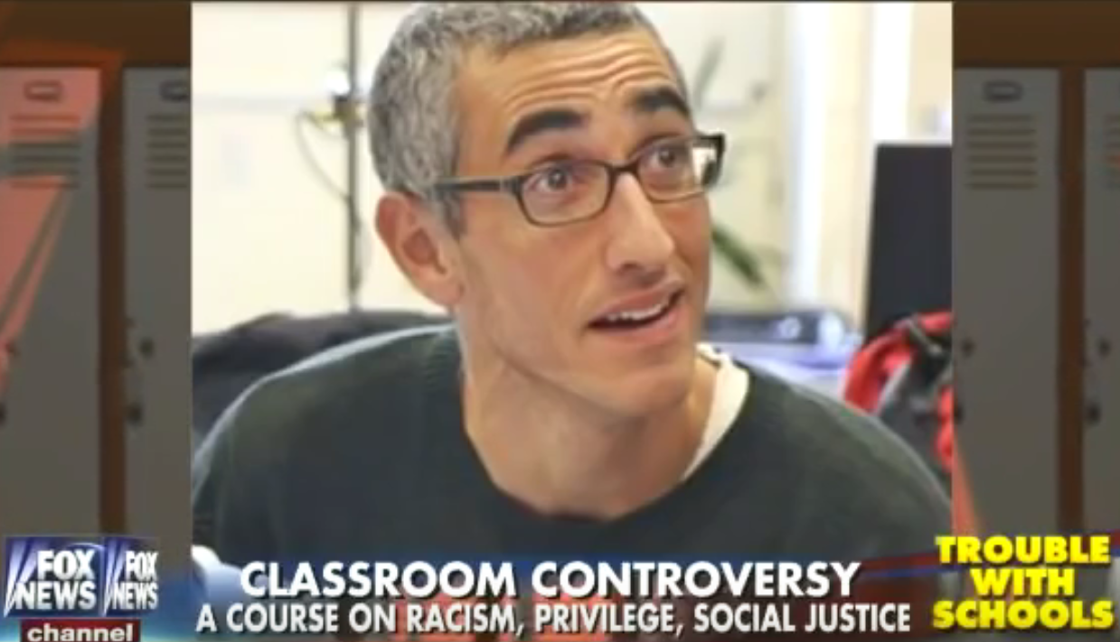
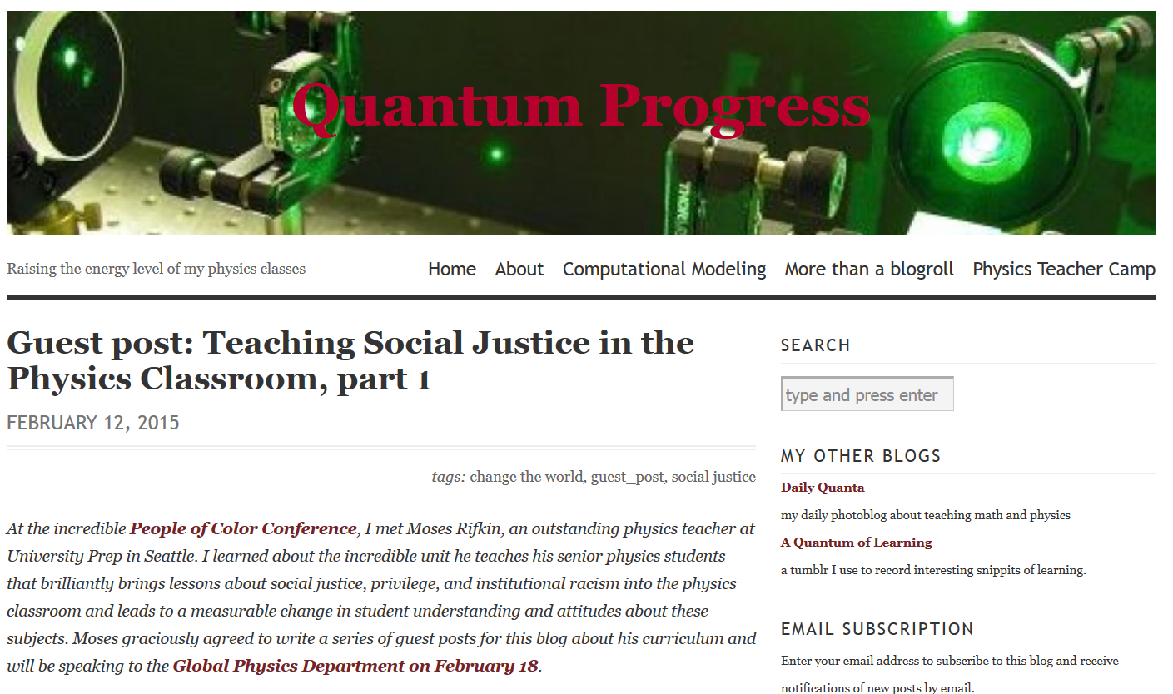
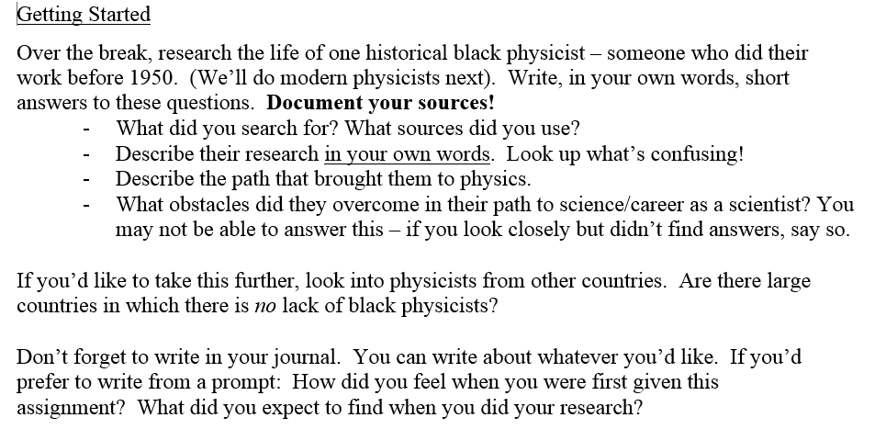
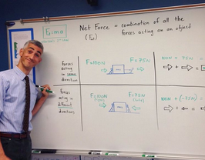
Welcome!
Introduce yourself to one person. What brought you here today?
Slides today: tinyurl.com/AAPTSM16
Twitter: @RiPhysKin #AAPTSM16 :: #PT4SJ :: #SoJustEdu
About Me:
Age 21: Science teaching
Age 25: Social Justice
How do I combine these halves?
Age 26: First attempts
Age 35: Media stardom
Age 36: AAPT 2016!

Slide 3
What is Physics Teaching for Social Justice?
Physics Teaching for Social Justice is:
Acknowledging a systemically imbalanced playing field
Working to undo that imbalance
This could include:
A critical examination of the historical impacts of physics
Using physics content to address modern inequality
Adapting our teaching practices to address imbalances
Exploring the current state and culture of physics with students
Generally: how can we transform our physics classrooms into agents of social justice?

Slide 4
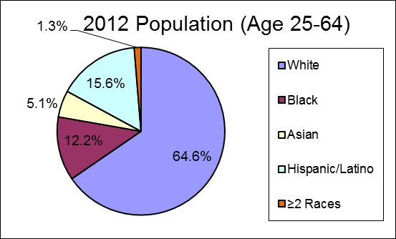
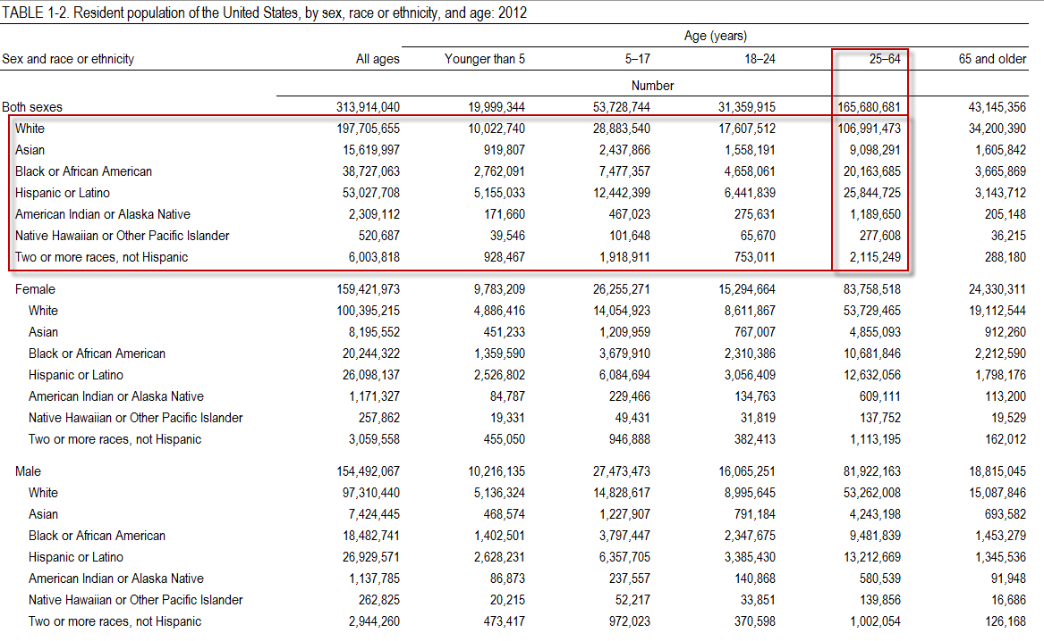
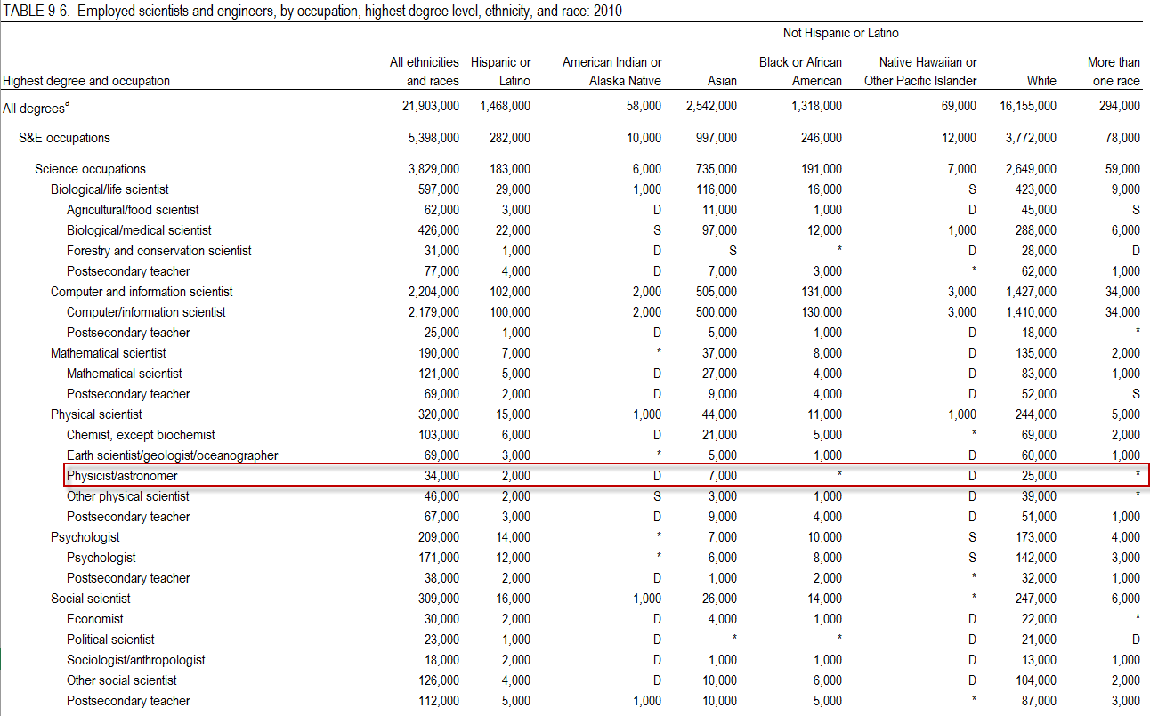
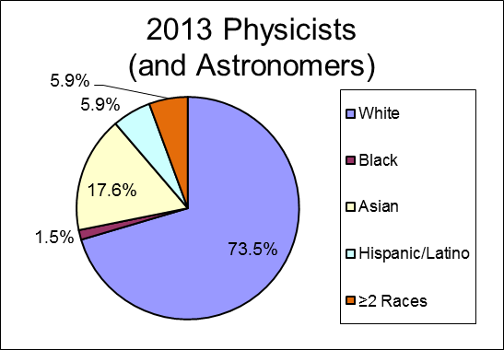
Who Does Physics?
The percentage of white people in the U.S. who identify as physicists is small…
…but it’s approximately 9.4 times larger than among black people in the U.S.

Slide 5
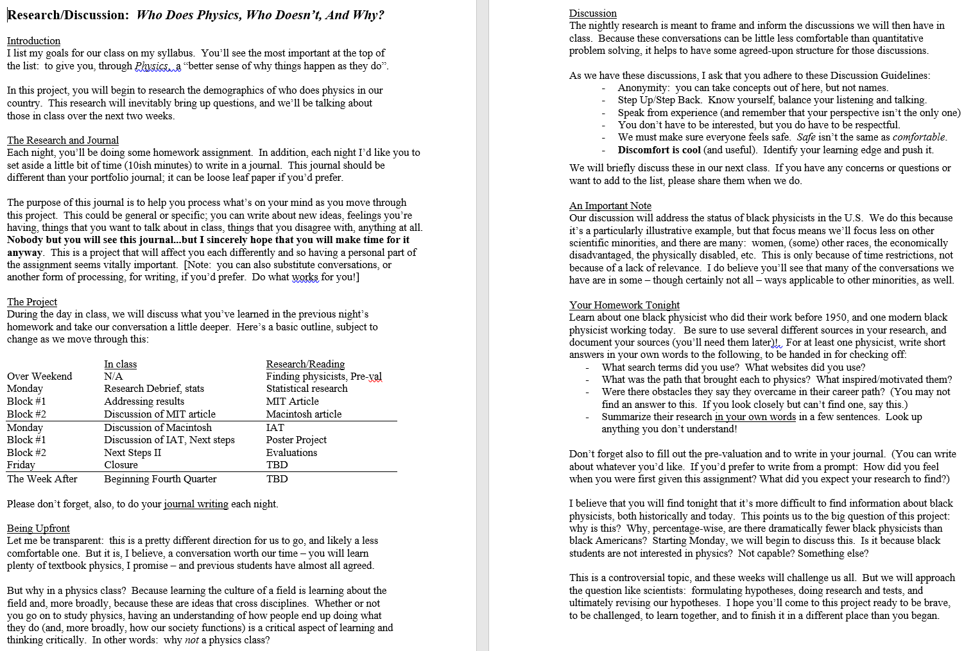
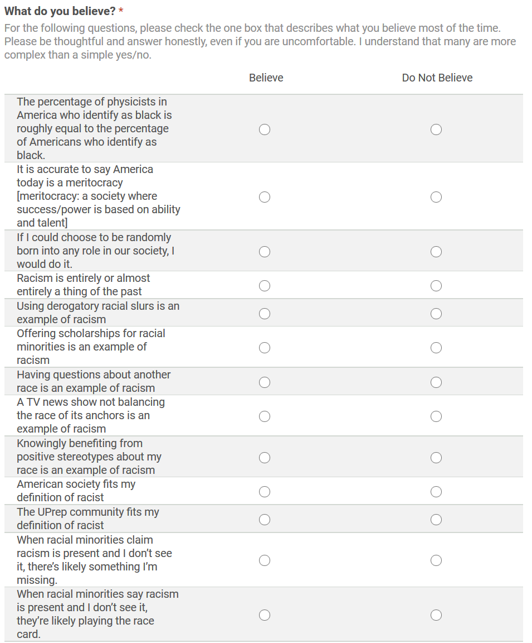
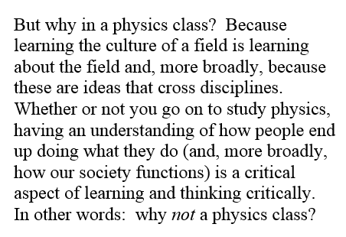
Starting Out

Slide 6
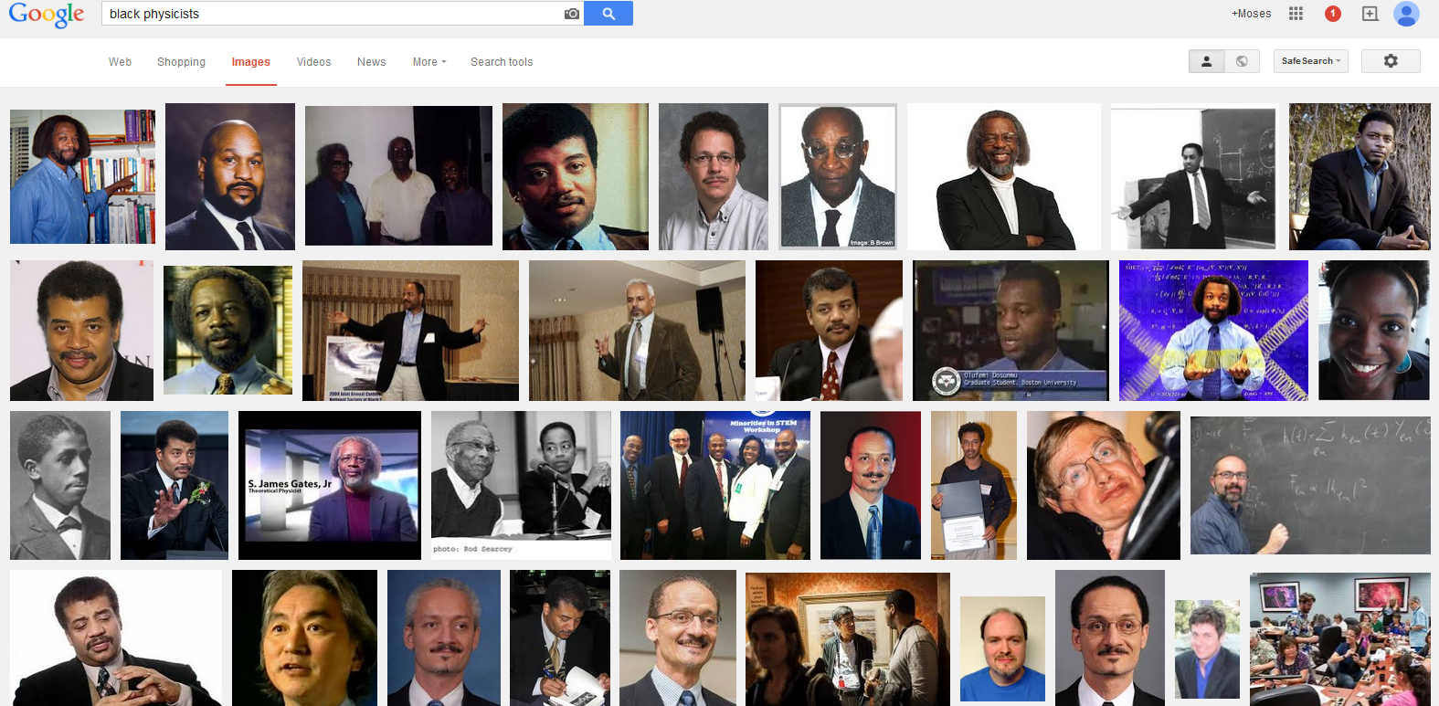
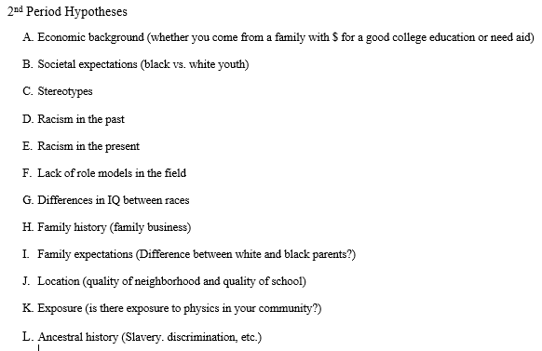
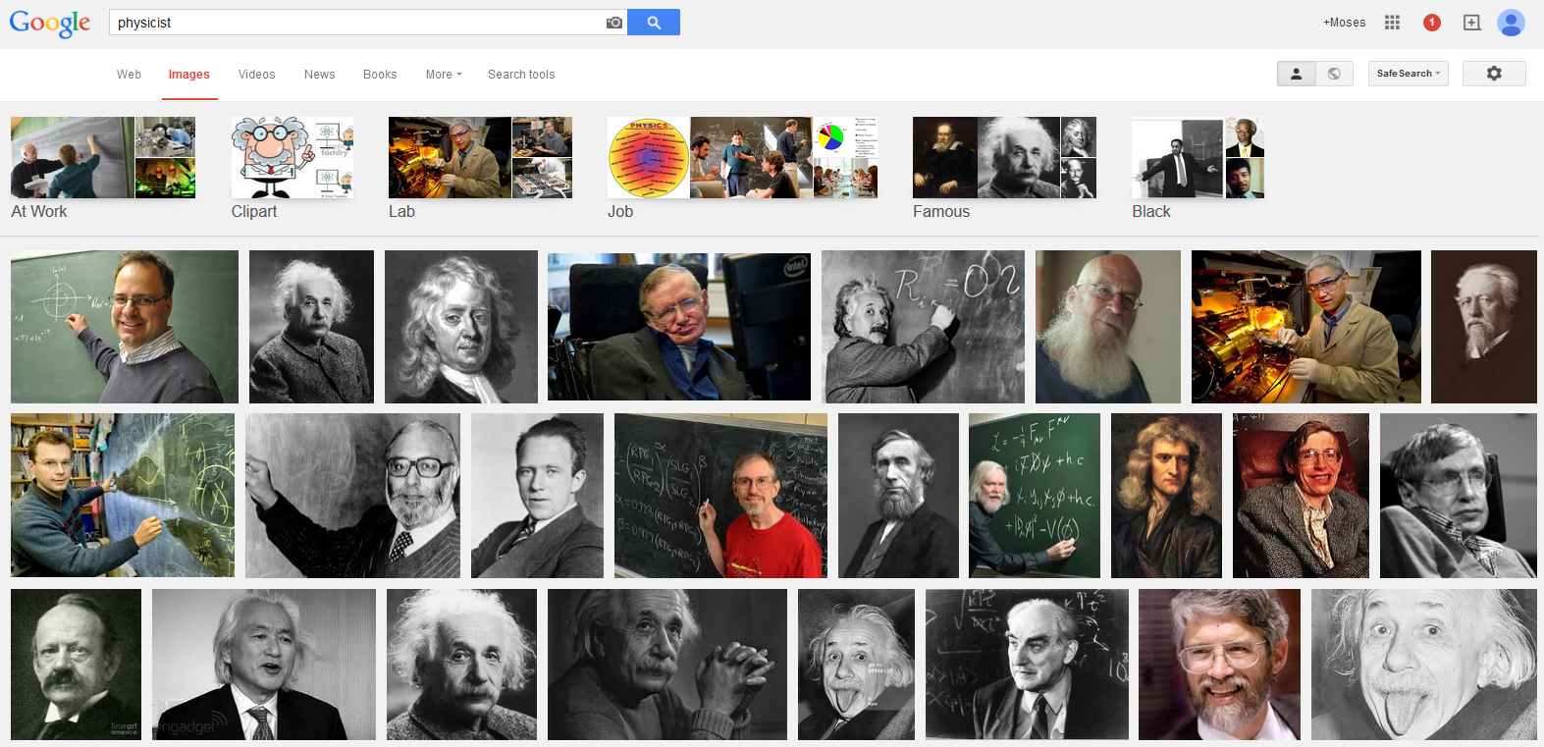
Learning – Hypothesizing – Learning
Formation of hypotheses
Data analysis
Revisiting and modifying hypotheses
NGSS and Culture: “science as a human endeavor”
NGSS and Models: “investigating and explaining causal relationships and the mechanisms by which they are mediated”

Slide 7
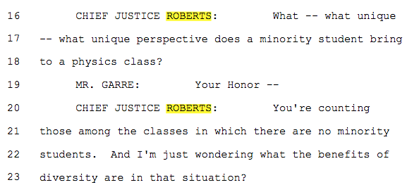
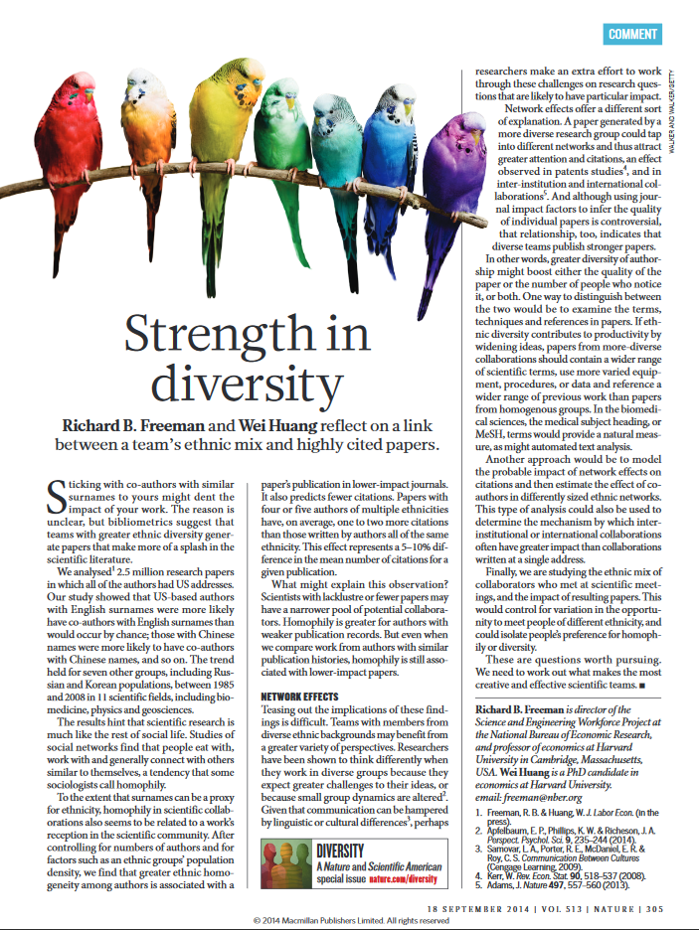
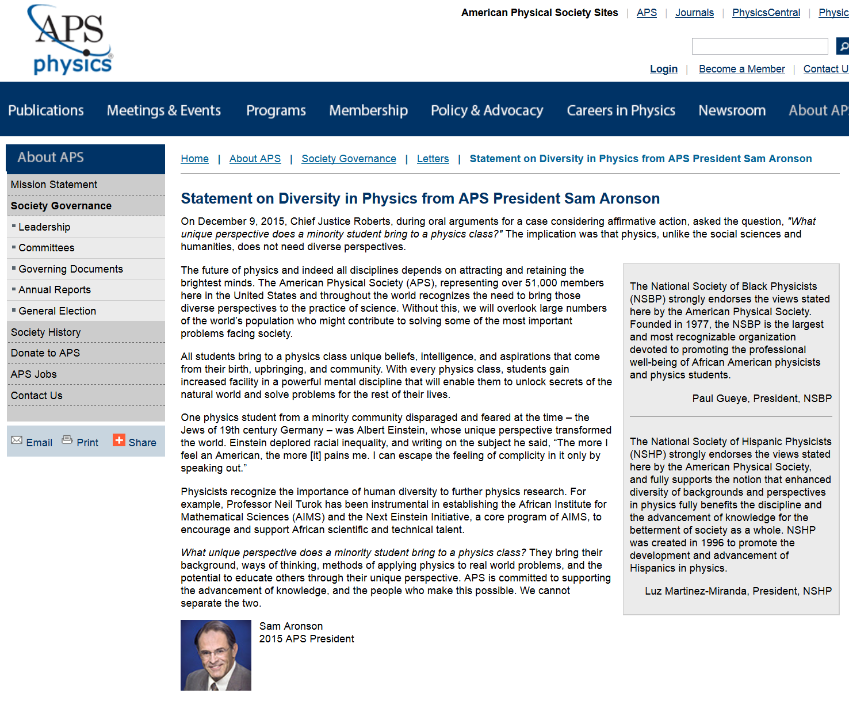
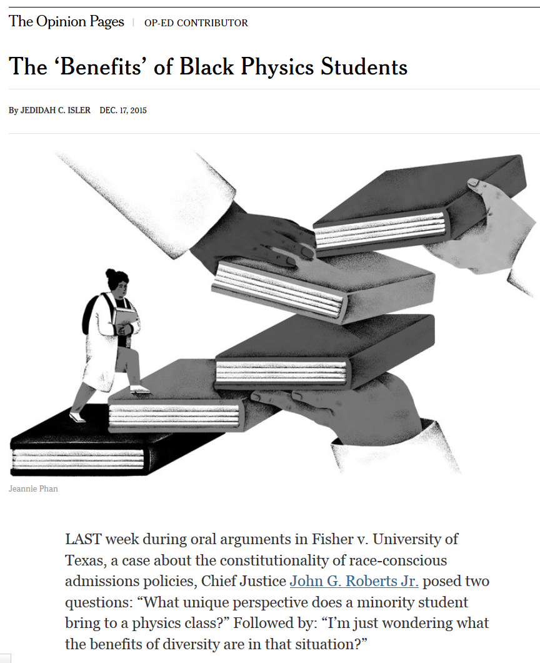
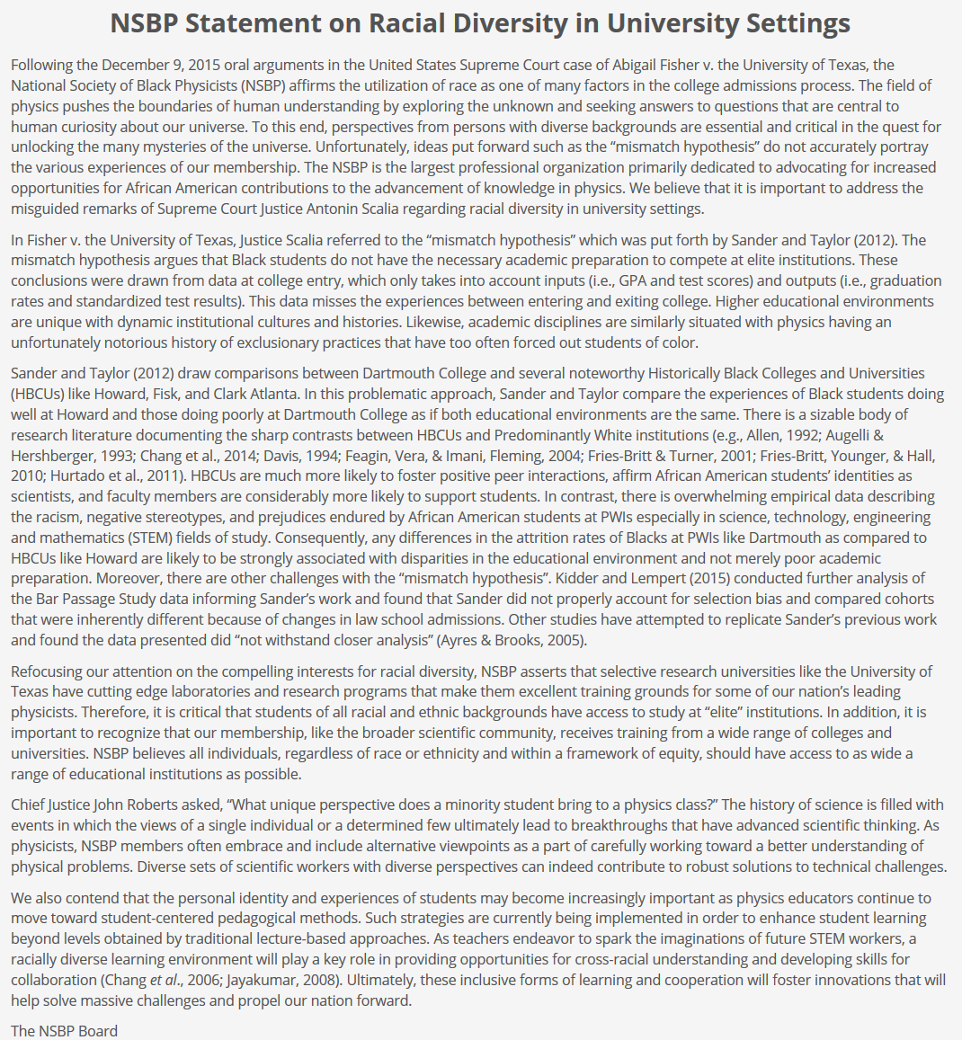
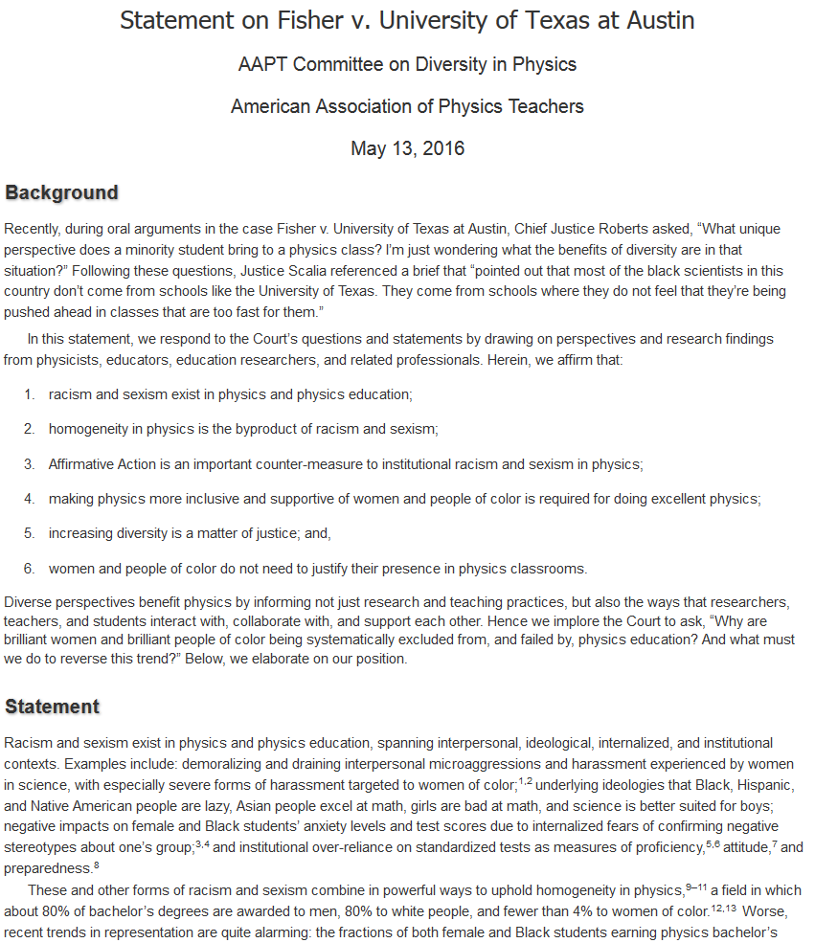
Does Diversity Even Matter?
“The stark homogeneity in physics is a byproduct of racism and sexism in physics….
Why are brilliant women and brilliant people of color being systematically excluded from, and failed by, physics education? And what must we do to reverse this trend?”
American Physical Society
Dr. Jedidah Isler (and others)
National Society of Black Physicists
American Association of Physics Teachers

Slide 8
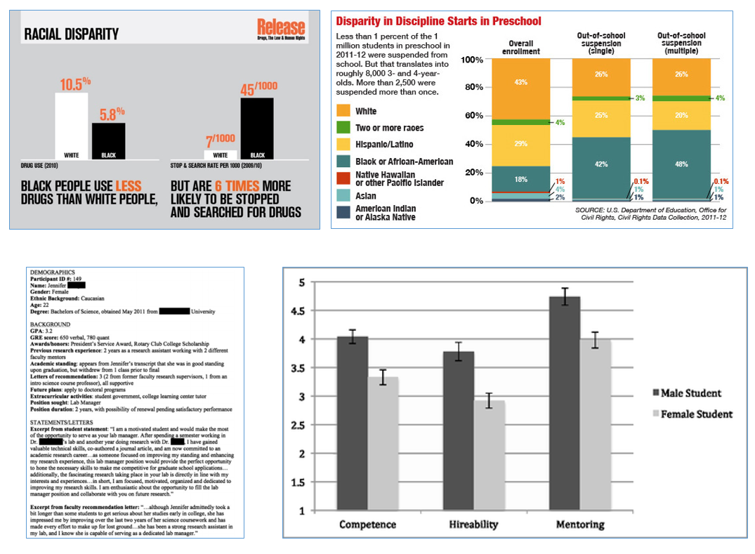
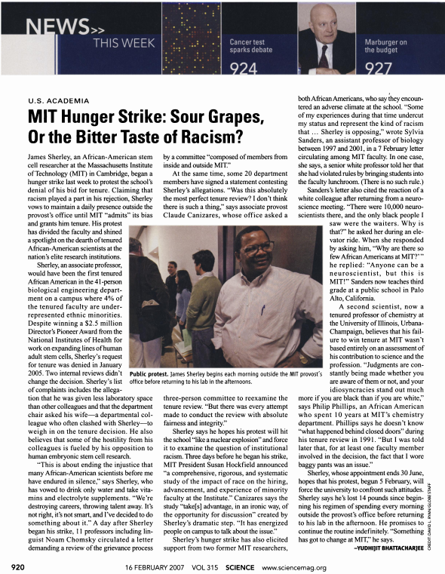
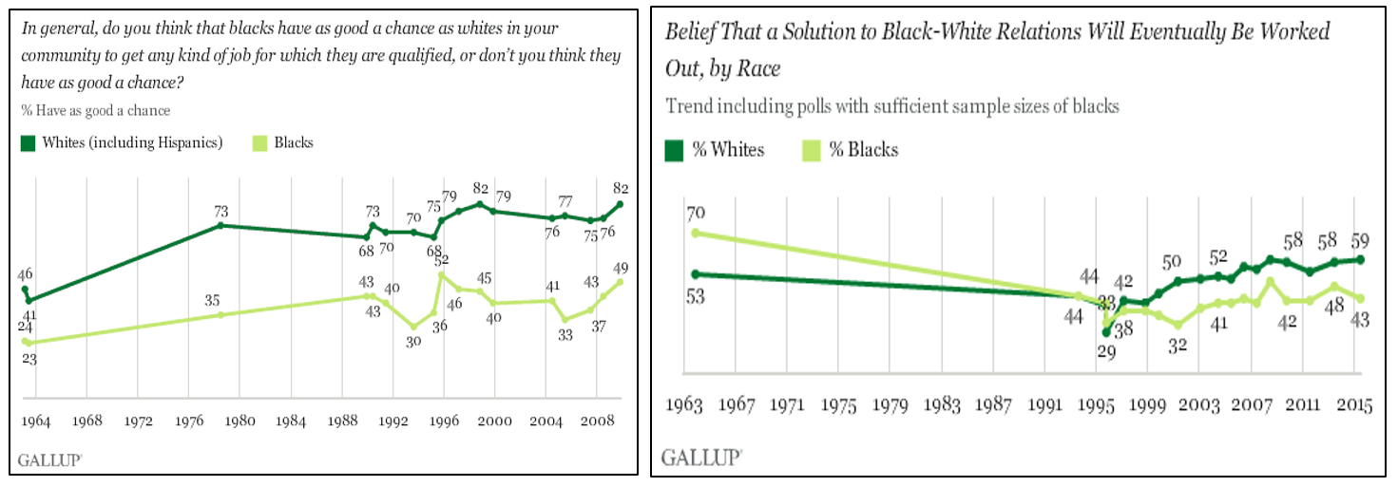
Expanding Definitions
James Sherley: discussion of complexity
Bad researcher? (“the race card”)
4% of M.I.T. tenured faculty are URM? (“racism”)
What is racism, anyways?
Overt racism: one race is superior to another
Systemic/institutional racism: system of power-based
advantages based on race
What about our communities?
“American society fits my definition of racist” 38/71%
“Our school community fits my definition of racist” 10/34%

Slide 9
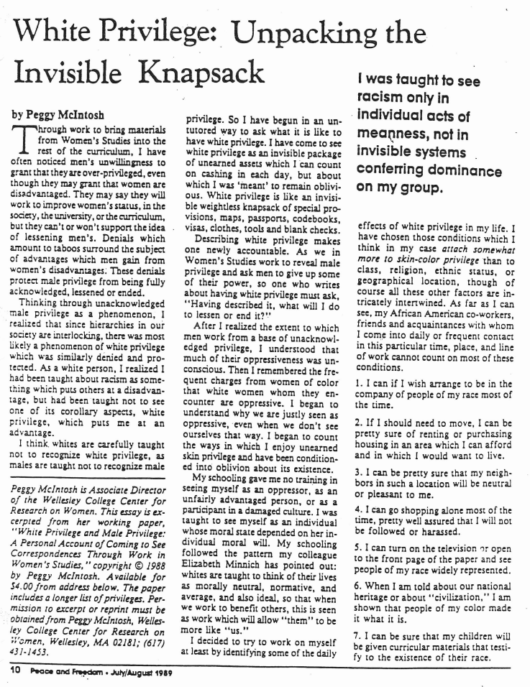
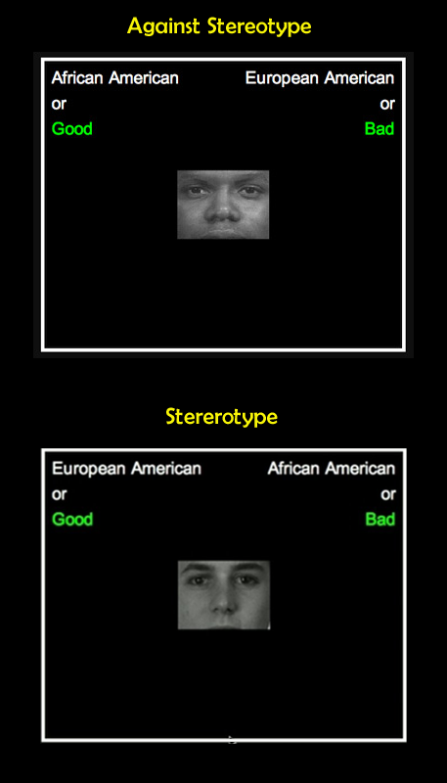
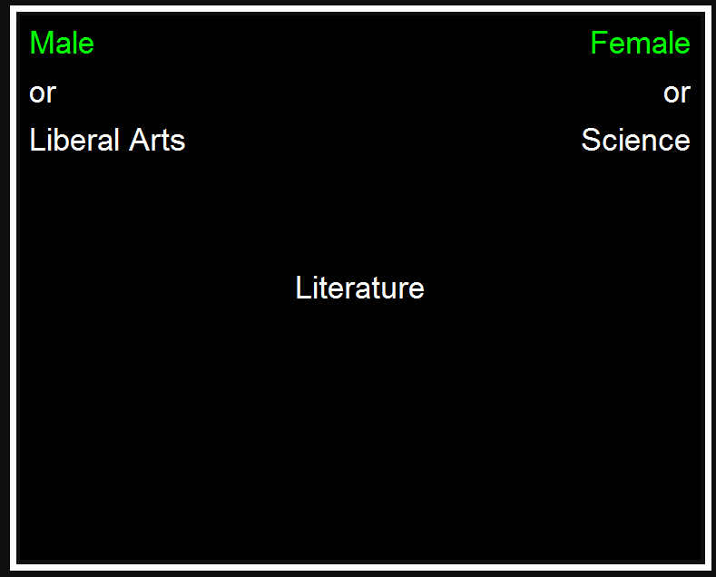
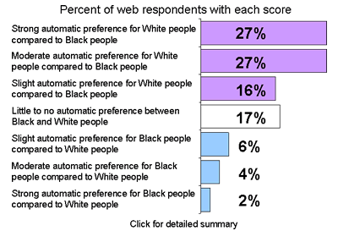
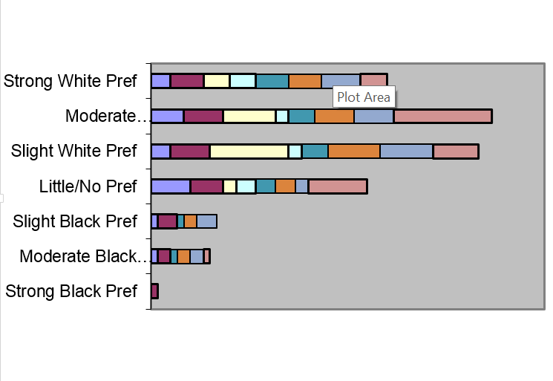
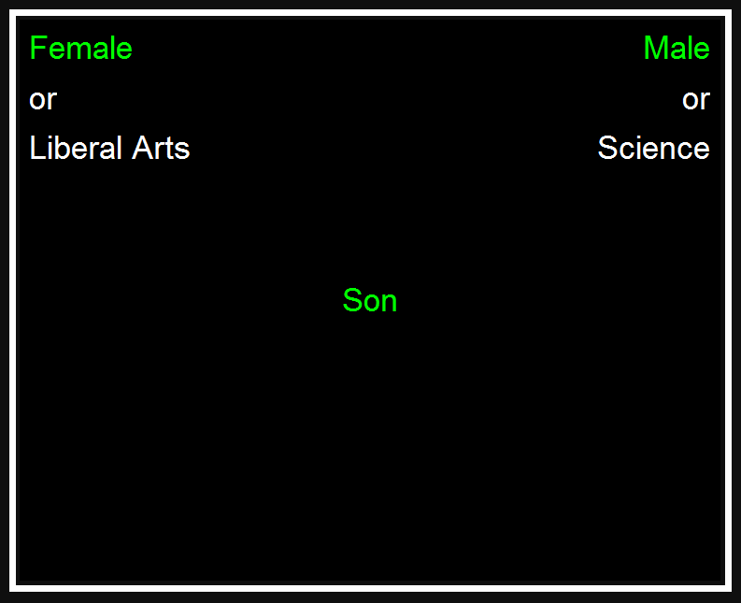
National ⇨ Local ⇨ Personal

Slide 10
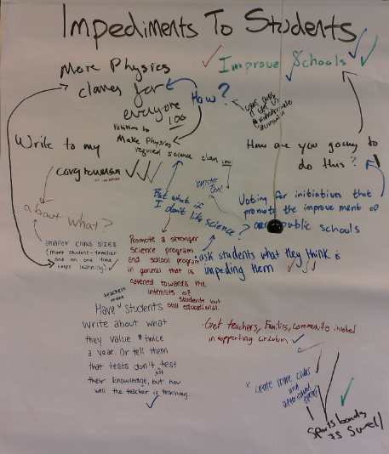
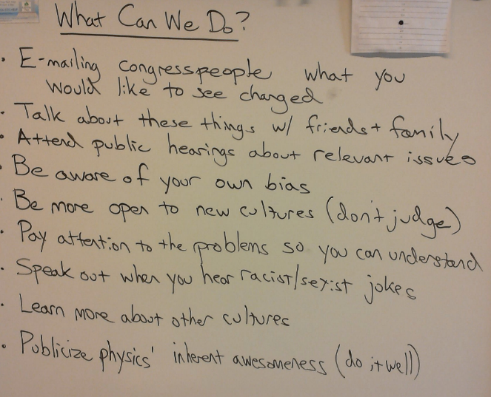
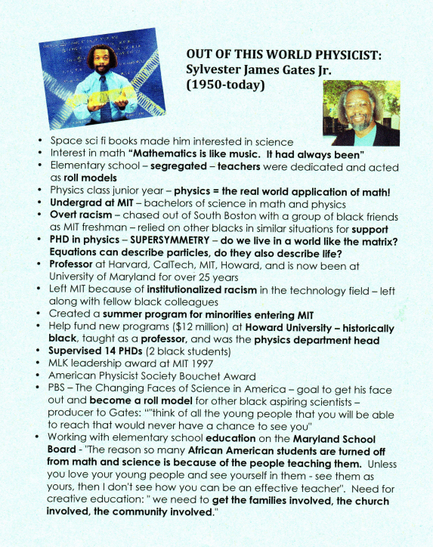
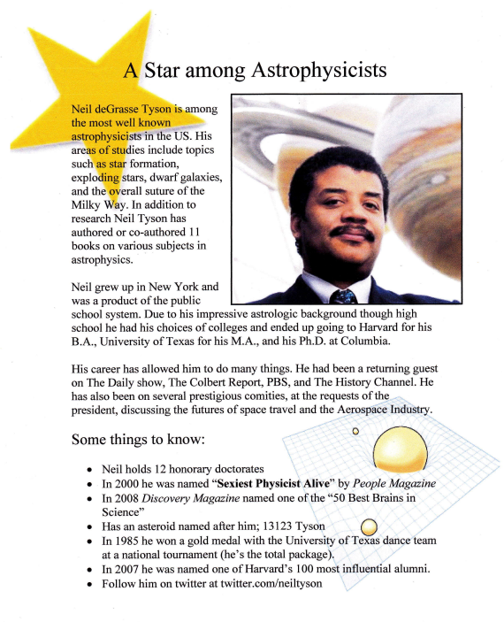
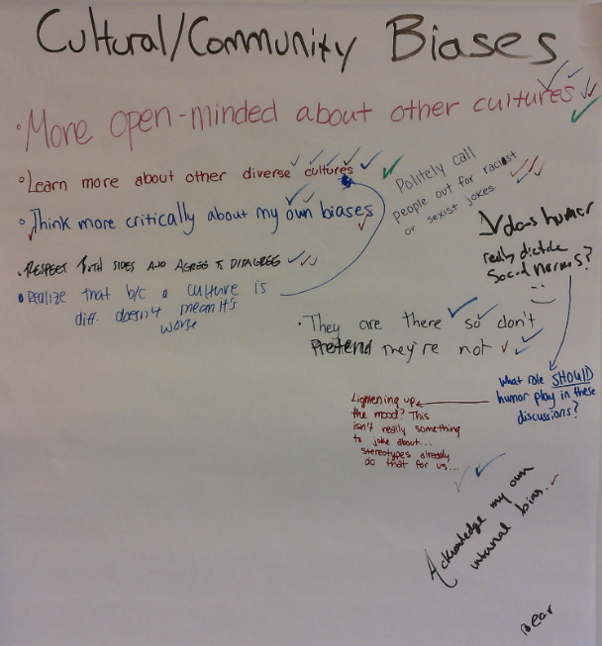
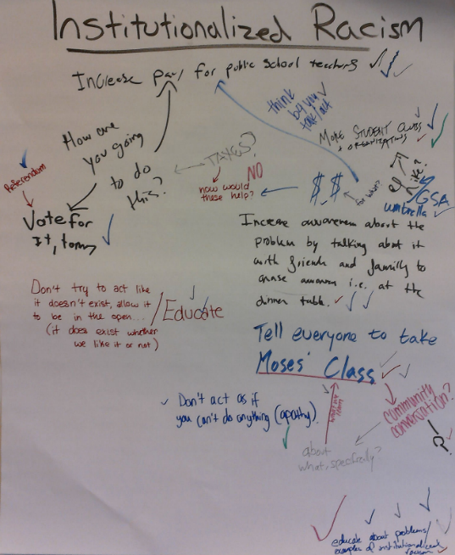
Action Steps

Slide 11
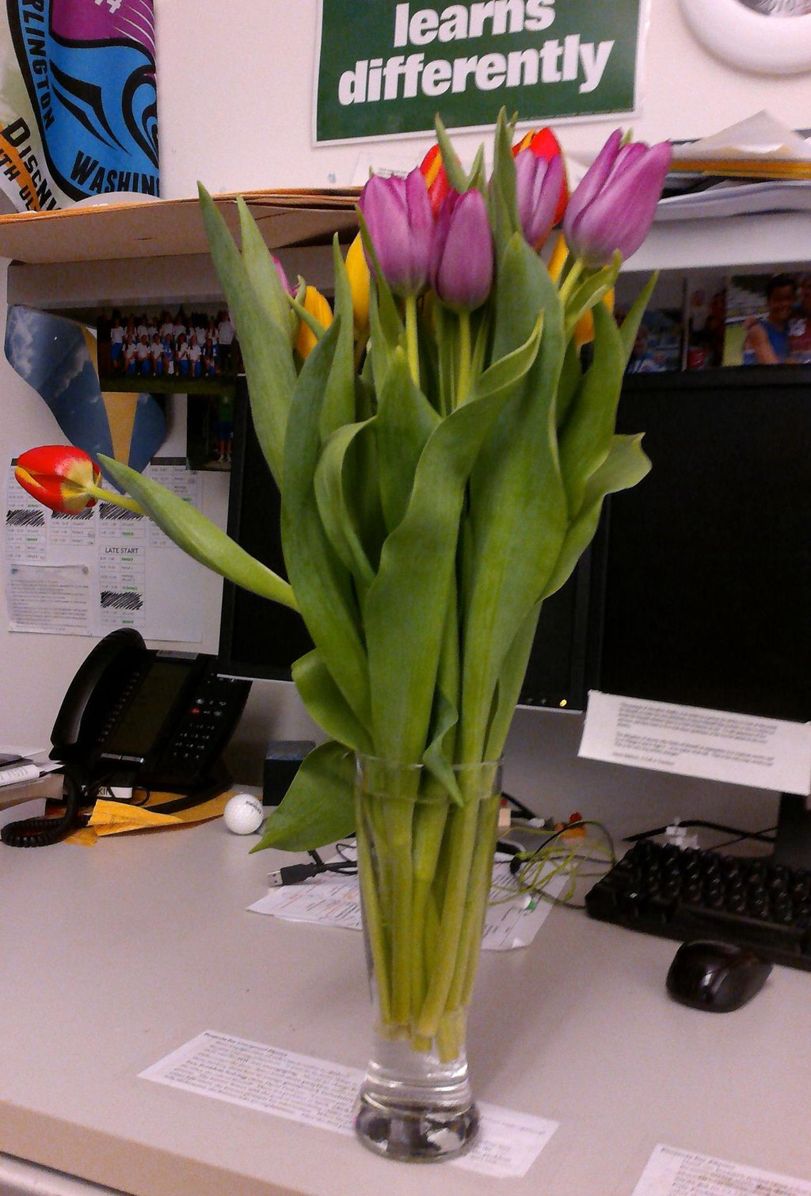
Things That ARE NOT Challenges (surprisingly)
Initial student buy-in
Convincing students of imbalance
Student appreciation of the time
71%: definitely worthwhile
25%: somewhat worthwhile
3%: not worthwhile
Creating an open space (my bias)
Parental pushback
Administrative pushback
“University Prep is fully aware of and supports Mr. Rifkin’s work with his students as part of our commitment to provide our students an education that helps them grow into socially responsible, intellectually courageous citizens of the world.”

Slide 12
Things That ARE ACTUALLY Challenges
Critical attention
Student resistance to individualization
Deeply-held belief in meritocracy
Tension between Problem/Solution focus
Staying Safe vs. Being Honest
Not enough time (gender, LGBTQ+)
My own discomfort

Slide 13
Student Responses – Does It Belong?
97% of my students said the unit was “definitely”/“somewhat” worthwhile
“There's really no class that would be "better" to talk about it in, and race in physics are intertwined when you look at the statistics.”
“It does relate to what we learn. By discussing it in physics, we are able to connect what we have learned to other things in ‘real life.’ By learning about it, I feel less discouraged from perhaps pursuing a course in math or science.”
“It's important that students who are averse to subjects that are more likely to discuss issues of social justice be culturally competent. It's ridiculous to provide only a subset of the student population with the responsibility to be socially aware while those who are interested in science classes can use their academic interests as an excuse to be ignorant.”
“Social Justice applies to everyone, everywhere, at any time.”

Slide 14
Student Responses – Physics Identity
(-6%)
(-3%)
(-3%)
(-7%)
(+7%)
(+7%)
“Others recognize my physics abilities”
“I can succeed in the discipline of physics”
“I can understand physics”
“I feel I can be myself in this class”
“I see myself as a science person”
“My teacher sees me as a physics person”
+ 15%
+ 15%
+ 27% (to 100%)
+ 27% (to 100%)
+ 16%
+ 47%

Slide 15
Closure
This is what works for my skills/interests and my students needs/identities
How can you transform your physics classrooms into an agent of social justice?
A critical examination of the historical impacts of physics
Using physics content to address modern inequality
Adapting our teaching practices to address those imbalances
Exploring the current state and culture of physics with students
~5 min of questions
I’d love to talk more! mrifkin@universityprep.org @RiPhysKin
This presentation tinyurl.com/AAPTSM16
More detail about my curriculum: tinyurl.com/BlogMoses
STEM Educators for Social Justice tinyurl.com/SE4SJ

